Slide 1
Hotel Booking Cancellations
Bijen Manandhar
Erum Qureshi
Mana Sandhu
Mike Barbiere
Naomi Gonzalez

Slide 2


Our Team
Bijen Manandhar
Mana Sandhu
Naomi Gonzalez
Mike Barbiere
Erum Qureshi

Slide 3

Overview
Business Case
Data Explanation
Modeling Approaches & Metrics used for Model Selection
Insights from Modeling
Outline on Next Steps

Slide 4
Business Problem Defined

Slide 5
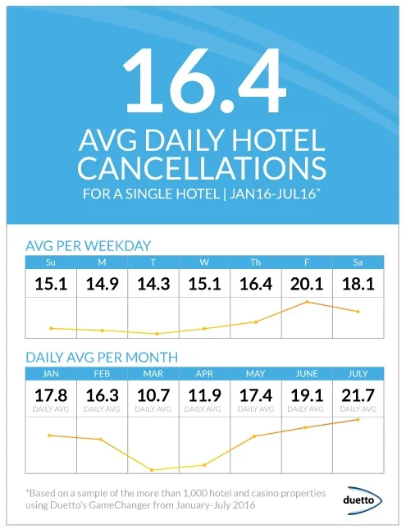
Cost of Booking Cancellation?
Source: Duetto’s Revene Strategy Solution - GameChanger¹

Slide 6
Economic Impact
Average Room Cost: $103
Average Net Revenue per Room: 68%
Average Number of Rooms / Hotel: 149
Rebooking Rate: 50%?
Average Occupancy Rates: 40%
Number of Hotels in USA in 2020: 85,285
103 * 149 * 85,285 * 0.40 = $523,547,558
523,547,558 * 0.68 = $356,012,339 Net Revenue
356,012,339 * 0.16 = $56,961,974 per day across USA.
In 2018, the annual revenue of the hotel industry in USA hit $218B.
Data taken from the five largest cities in the United States, according to population size, show that the average cost of a single-night hotel room is $103.27
Data from 2016 reported an average of 68.1% of total operating revenue is derived from hotel room bookings.
Cancellation rates were found to be 16.4% across hotel type, per day in 2016.
Average hotel occupancy rate is estimated to be 40.3% monthly.

Slide 7
Business Problem
Objective: Create a model that allows a hotel to accurately forecast how many rooms it is able to book to set up its revenue management strategy and prevent revenue loss.
What percentage of customers cancel reservations or are “no shows?”
What are the reasons that a customer may cancel their reservation in relation to the variables included in our dataset?
Deploy a model to properly forecast the number of reservations that will be cancelled to optimize the hotel’s room inventory management and maximize revenue.
Recommend a solution for the hotel’s room reservation approach.

Slide 8

Questions to explore
What variables will factor into a customer cancellation (e.g.: no. of children, connecting flight, date of travel, etc.)?
How advance was the reservation made?
What country is the customer travelling from?
What months are the busiest in terms of hotel bookings?
How long are customers staying at the hotel?
How many bookings is the hotel seeing a year?

Slide 9
Dataset Explained

Slide 10
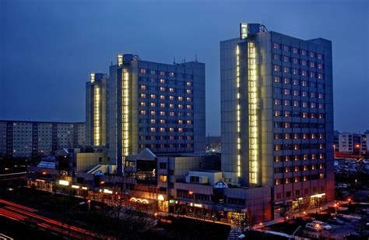
About the Dataset
Retrieved from Kaggle.com
Assembled from two large datasets of separate hotels, defined as Resort and City locations.
Resort (H1): the destination-area of Algarve, Portugal
City (H2): within the city of Lisbon
Original source: ScienceDirect.com ¹

Slide 11
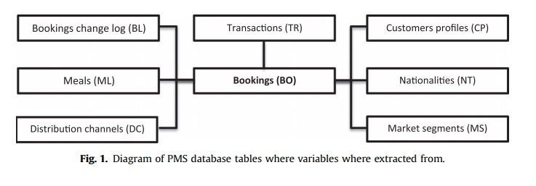
Compilation of Dataset
Real hotel data that share a similar structure, 31 variables describing 40,060 observations of H1 and 79,330 observations of H2.
Records indicate bookings between July 1st, 2015 and August 31st, 2017; however, data were extracted from the bookings change log (i.e., the day prior to arrival date) due to temporal nature of reservations.

Slide 12
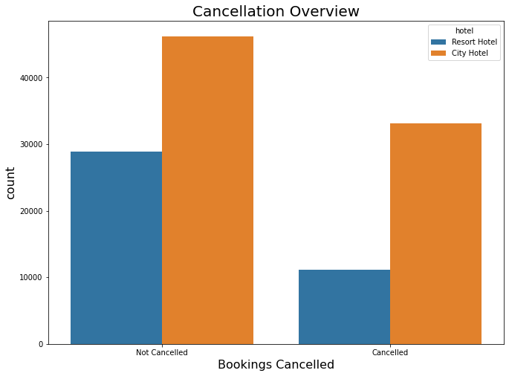
Determining Target Variable
Cancellations were classified in the ‘is_canceled’ column, and later dummy coded into binary responses.
Cancellation rates varied by hotel district; H2 (city location) had much higher rate of cancellations compared to the resort location.

Slide 13
Determining Input Variables
Several variables had too many missing variables and were dropped:
‘Company’, ‘Agent’
‘Reservation_Status’ contained the same data as the target variable.
Also, a couple columns had high cardinality (i.e., more then 100 unique values).
‘Country’, ‘Reservation_Status_Date’

Slide 14
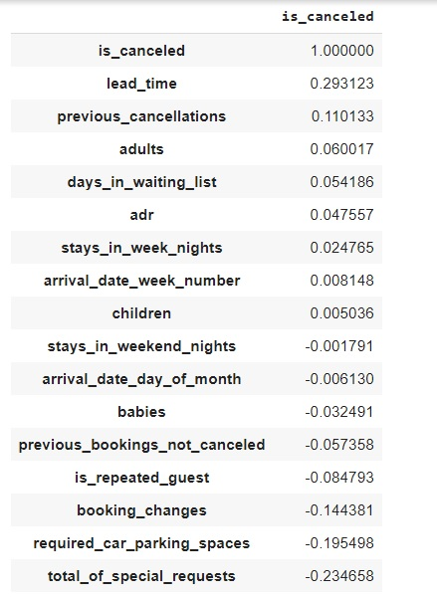
Determining Input Variables
The remaining columns were included as predictor variables in the modeling.
Correlations between various numerical predictors and the target variable:
Lead Time – 0.29
Previous Cancellations – 0.11
Booking Changes – -0.14
Required Parking Spaces – -0.19
Total # Special Requests – -0.23

Slide 15
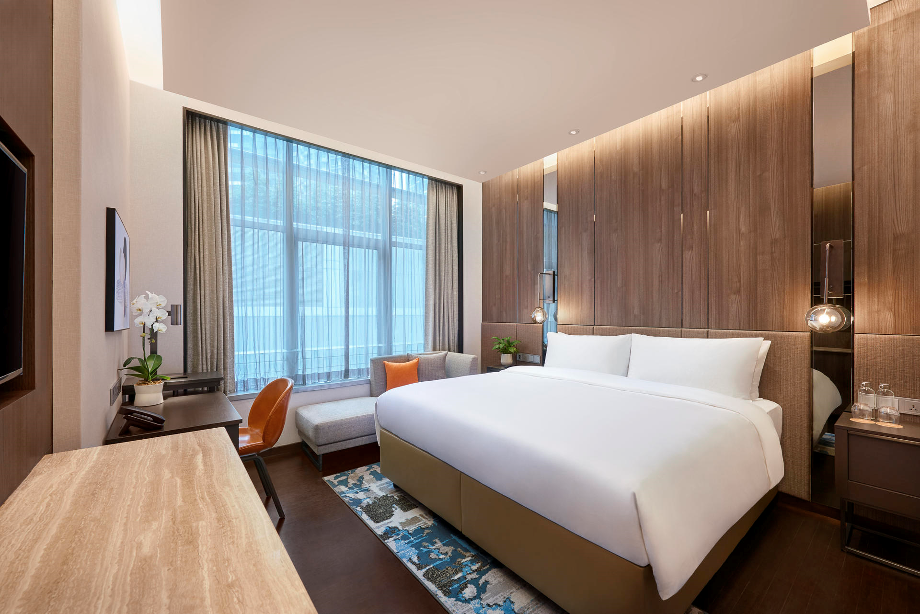
Predictors
Most attributes were common sense; however, some categorical variable columns needed explanation.
Total of Special Requests
Meal
Deposit Type
Distribution Channel
Company

Slide 16
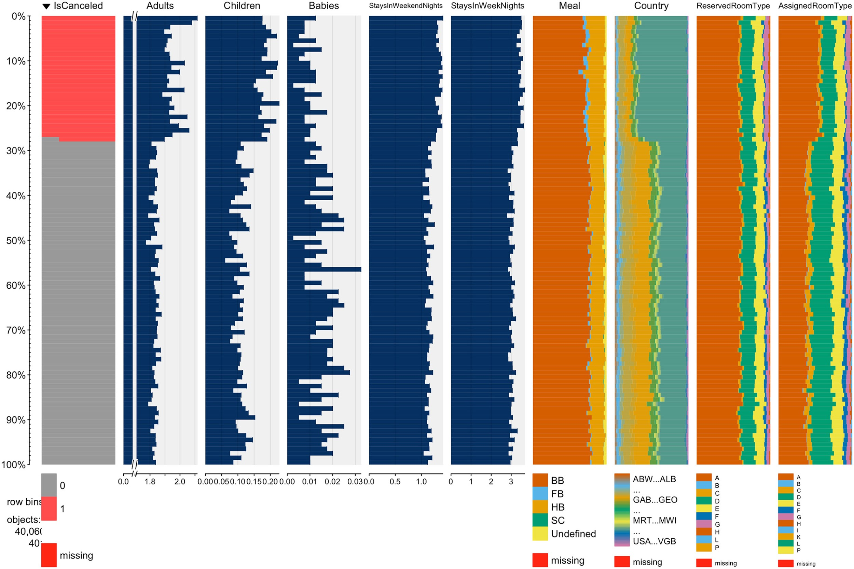
H1: Resort Area of Algarve, PT

Slide 17
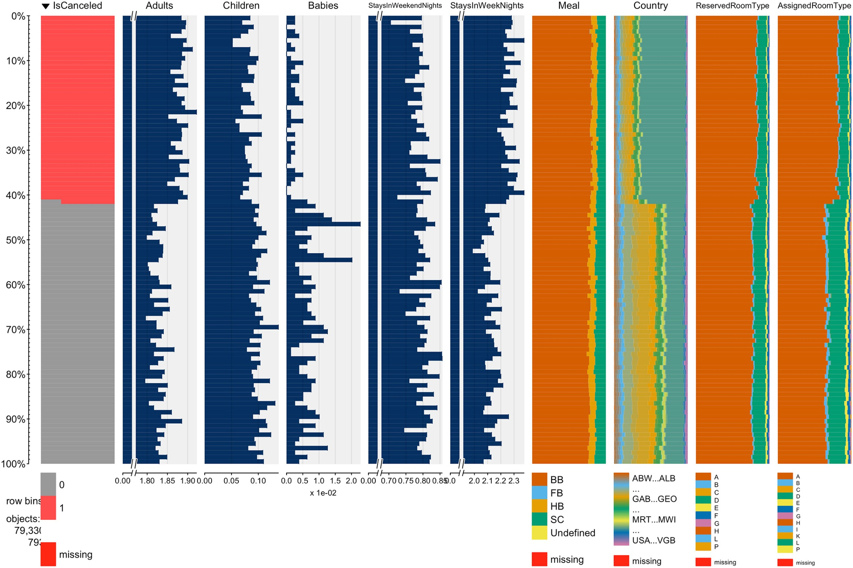
H2: City of Lisbon, PT

Slide 18
Explanation of Modeling Approaches

Slide 19
Supervised Learning Algorithms Used
Modeling: Classification
Logistic Regression
K-Nearest Neighbors (KNN)
Random Forest
Boosted Tree
Naive Bayes Classifier
Artificial Neural Network (ANN)
Deep Sequential Neural Network

Slide 20
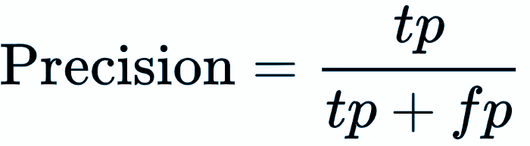
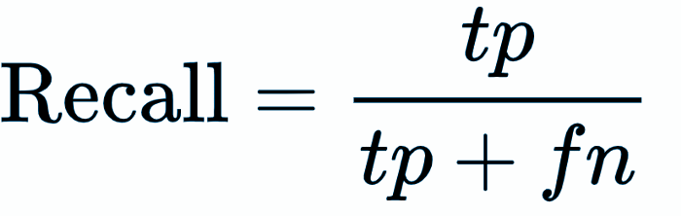
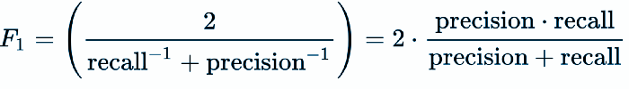
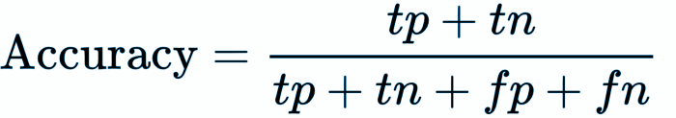
Performance Metrics
Confusion Matrix
Classification Report
Precision
Recall
F1-Score
Accuracy
ROC AUC Score
For this business problem, we will use the model which provides us higher accuracy.
Notes:
Precision : When predicted bookings are cancelled, how often is it actually correct? (FP focus)
Recall: When the bookings are actually cancelled, how often does it predict correctly? (FN focus)
F1: Weighted average between precision and recall. Useful when dealing with unbalanced samples
Accuracy: The sum of true positive and true negative divided by the total number of sample.
ROC AUC:provides an aggregate measure of performance across all possible classification thresholds

Slide 21
Model Performance
Model | Metrics | Precision | Recall | F1 Score | Accuracy | Area Under Curve
Logistic Regression | 83% | 59% | 69% | 80% | 0.760
KNN | 82% | 66% | 73% | 82% | 0.786
Random Forest | 99% | 37% | 54% | 77% | 0.684
Boosted Tree | 84% | 62% | 71% | 82% | 0.775
Naive Bayes | 53% | 52% | 52% | 65% | 0.621
Artificial Neural Network | 82% | 67% | 74% | 82% | 0.793
Sequential Neural Network | 85% | 65% | 74% | 83% | 0.790
Notes:
Precision : When predicted bookings are cancelled, how often is it actually correct? (FP focus)
Recall: When the bookings are actually cancelled, how often does it predict correctly? (FN focus)
F1: Weighted average between precision and recall. Useful when dealing with unbalanced samples
Accuracy: The sum of true positive and true negative divided by the total number of sample.
ROC AUC:provides an aggregate measure of performance across all possible classification thresholds

Slide 22
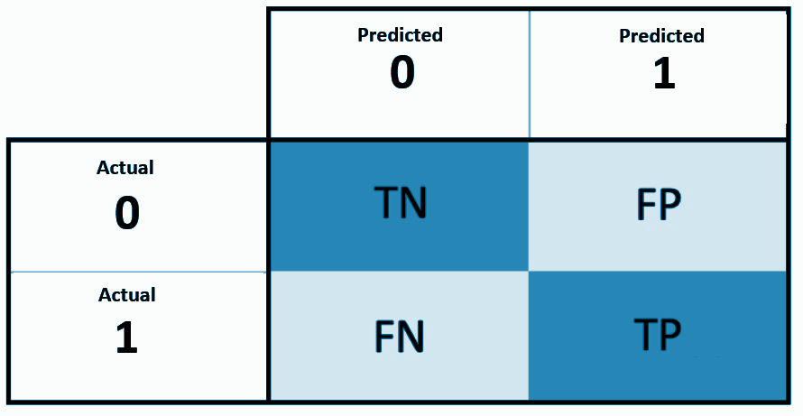
Confusion Matrix
Sequential Neural Network
 | Predicted 0 | Predicted 1
Actual 0 | 20945 | 1579
Actual 1 | 4629 | 8664
Precision | Recall | F1 Score | Accuracy | Area Under Curve
85% | 65% | 74% | 83% | 0.790
Notes:
Precision : When predicted bookings are cancelled, how often is it actually correct? (FP focus)
Recall: When the bookings are actually cancelled, how often does it predict correctly? (FN focus)
F1: Weighted average between precision and recall. Useful when dealing with unbalanced samples
Accuracy: The sum of true positive and true negative divided by the total number of sample.

Slide 23
Insights From Modeling

Slide 24
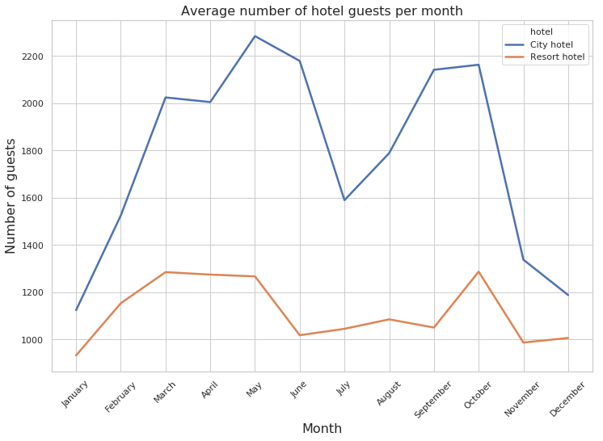
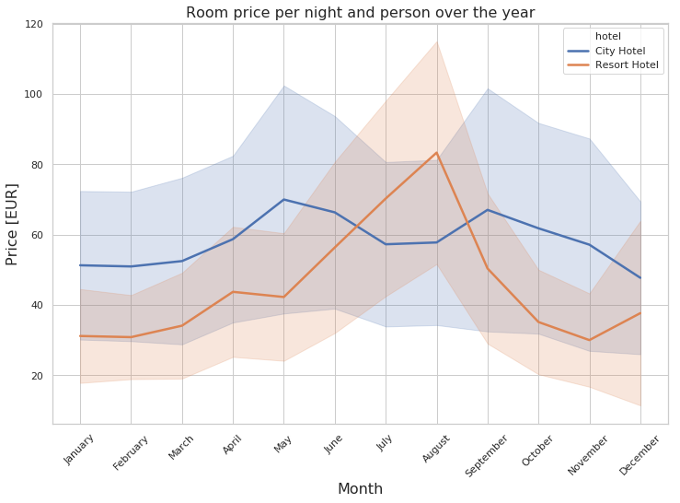
Bookings
Resort hotels have less bookings compared to the city hotels
Resort hotels can focus more on marketing in order to increase bookings in off-season months
City hotels on average are more expensive across room types then resort hotels.
City hotels can provide price discounts in off-seasons to compete with resort hotels.

Slide 25
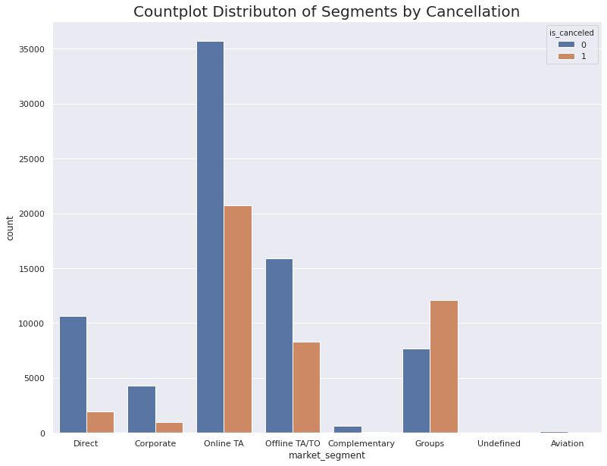
Market Segments
Group bookings had disproportionately higher cancellation rates.
Booking through Travel Agent and Tour Operation also saw higher rate of cancellation
Booking directly through the hotels, and part of corporate events saw smaller proportion of cancellations.
Hotels can promote to make individual bookings more likely than through agencies.

Slide 26
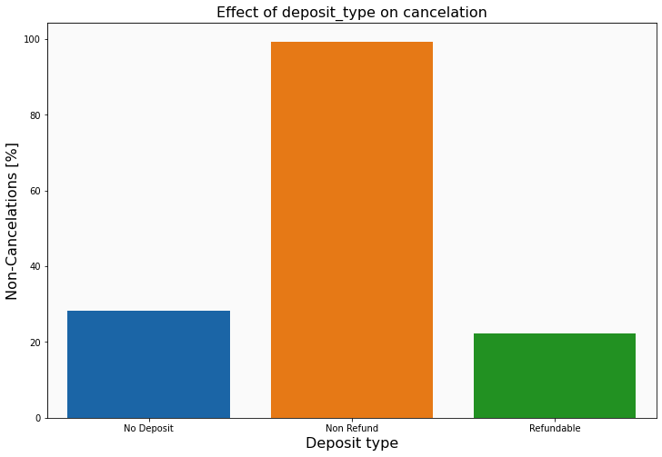
Deposit Type
Non-Refundable deposits were classified as customers who paid full cost of room in advance.
These customers were less likely to cancel their booking.
Customers who had the option not to put down a deposit, or make a partial deposit, were more likely to cancel their bookings.

Slide 27
Outline of Next Steps

Slide 28


How to reduce cancelations?
Customer
Oriented
Seasonal Rate
Corporate
Benefits
And Rewards
Encourage Payments of Deposits
Convenience
Notes:
Customer Oriented: We found out that customers who had special requests are less likely to cancel the booking. So, if we make the hotel bookings customer oriented that they are less likely to cancel the reservation.
Corporate Benefits and Rewards: We also found out that the corporate groups are less likely to cancel the booking. We can also build some reward systems such as point systems of booking and benefits to make less booking cancellations.
Convenience: Bookings in city hotels were more cancelled because of the parking issues and resorts were not having enough bookings because of its locations.
Encourage Payments of deposits: Travelers who make payment of deposits are less likely to cancel their bookings. As most of the travelers make bookings through agents today, they are not required to pay the deposits are more likely to cancel their bookings. So, hotels can encourage to book individually without the agent.
Seasonal Rate: During July, Resorts experience very high booking whereas city hotels dry up. So, there should be price optimization to get constant flow of bookings through out the year.

Slide 29

Thank You!
Customer special requests had fewer cancellations

